Slide 1
New York Property
Fraud Analytics
Team 5
Yao Lu
Bei Zhang
Roger Geng

Slide 2

Overview
Data Preprocessing
Feature Engineering
Algorithms
Results
Contents

Slide 3

01
FEATURE ENGINEERING

Slide 4
Variables Transformation
Create 3 sizes
· Lot area: LOTAREA = LTFRONT * LTDEPTH
· Building area: BLDAREA = BLDFRONT * BLDDEPTH
· Building volume: BLDVOL = BLDAREA * STORIES

Slide 5

Variables Transformation
FULLVAL
AVLAND AVTOT
LandArea
BuildArea
BuildVol
ALL
ZIP
ZIP3
TAXCLASS
BORO
STORIES
BORO + TAXCLASS
Divided by
Group by
3 x 3 x 7 = 63

Slide 6

Variable
Standardization
Scale to be Comparable

Slide 7

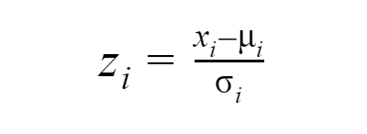
Variable
Standardization
z-scores have a distribution with a mean of 0 and a standard deviation of 1.

Slide 8
Principal Component Analysis
Variable
Standardization
Reduce dimension
Scale to be Comparable

Slide 9
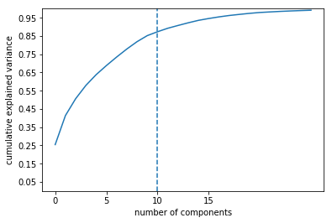
To remove these correlations and achieve a reduction in dimensions
 | Percentage of explained variance
PC1 | 25.44%
PC2 | 15.94%
PC3 | 9.26%
PC4 | 7.29%
PC5 | 5.87%
PC6 | 4.99%
PC7 | 4.67%
PC8 | 4.42%
PC9 | 4.03%
PC10 | 3.32%
Principal Component Analysis
(PCA)

Slide 10
PC Standardization
Principal Component Analysis
Scale to be Comparable
Variable
Standardization
Reduce dimension
Scale to be Comparable

Slide 11
02
MODEL ALGORITHMS

Slide 12
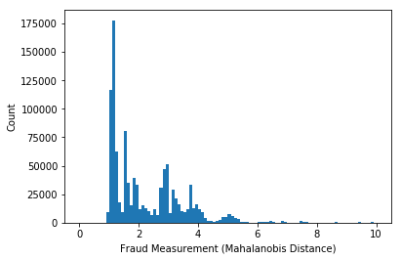
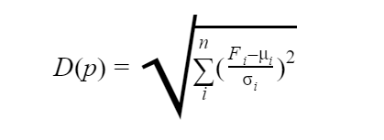
Mahalanobis Distance

